Slide 1
Ultrasonic-Sensor based Park-Assist System
Rishabh Pomaje – 210020036@iitdh.ac.in
Ganesh Panduranga Karamsetty – 210020009@iitdh.ac.in

Slide 2
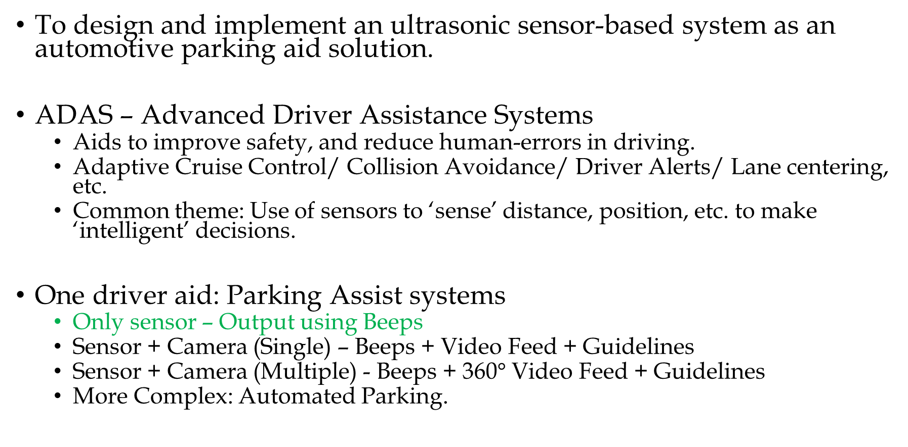
Objectives
To design and implement an ultrasonic sensor-based system as an automotive parking aid solution.
ADAS – Advanced Driver Assistance Systems
Aids to improve safety, and reduce human-errors in driving.
Adaptive Cruise Control/ Collision Avoidance/ Driver Alerts/ Lane centering, etc.
Common theme: Use of sensors to ‘sense’ distance, position, etc. to make ‘intelligent’ decisions.
One driver aid: Parking Assist systems
Only sensor – Output using Beeps
Sensor + Camera (Single) – Beeps + Video Feed + Guidelines
Sensor + Camera (Multiple) - Beeps + 360$°$ Video Feed + Guidelines
More Complex: Automated Parking.

Slide 3
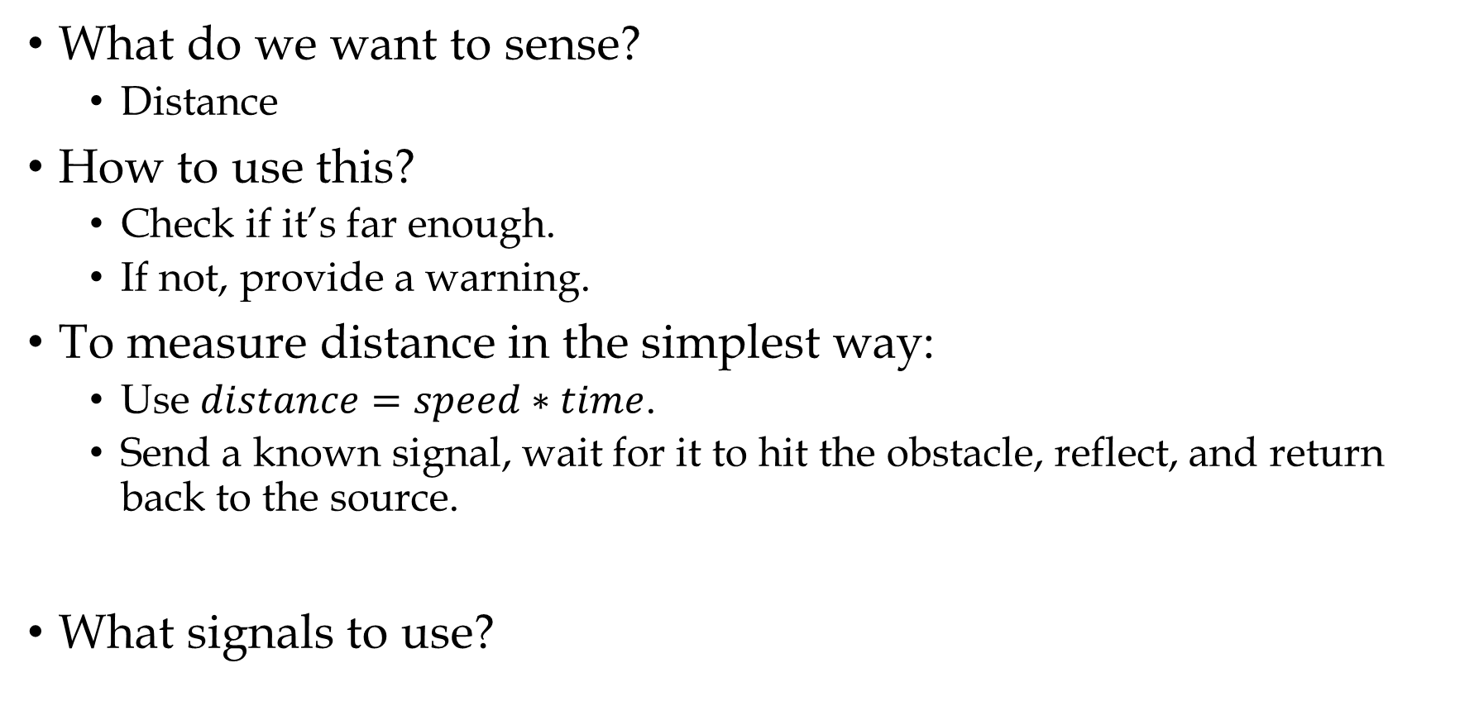
Approach
What do we want to sense?
Distance
How to use this?
Check if it’s far enough.
If not, provide a warning.
To measure distance in the simplest way:
Use $distance=speed∗time$.
Send a known signal, wait for it to hit the obstacle, reflect, and return back to the source.
What signals to use?

Slide 4
Background
Initially, infrared (IR) light waves were used.
Issues:
Interference with other sources e.g., Sun.
Uneven surfaces of the obstacle, minute particles (ex. dust) can also scatter the signal.
Ultrasonic sensor (US)
Basis: Send a pulse of ultrasonic sound (> 20kHz freq.) wave.
Proximity Sensor – Measure distance to nearest objects.
Invented by Dr. Tony Heyes, University of Nottingham.
1982: Toyota introduced it in Corona model.

Slide 5
Foundations – Working Principle
Ultrasonic Sensor
Tx
d
Ultrasonic Sensor
Rx
Obstacle
e.g., Wall, Other vehicles, etc.
(a)
(b)

Slide 6
Hardware
3.3V
5V
OLED
128 * 64
SSD1306
Tiva C series TM4C123G
LaunchPad
Evaluation Kit
SDA
TM4C123GH6PM
SCL
5V
GND
5V
Ultrasonic Sensor
HC-SR04
Echo
Trig
Ultrasonic Sensor
HC-SR04
Tx
Tx
Rx
Trig
Echo
Rx
GND
GND
GND

Slide 7
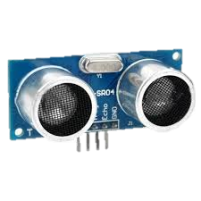
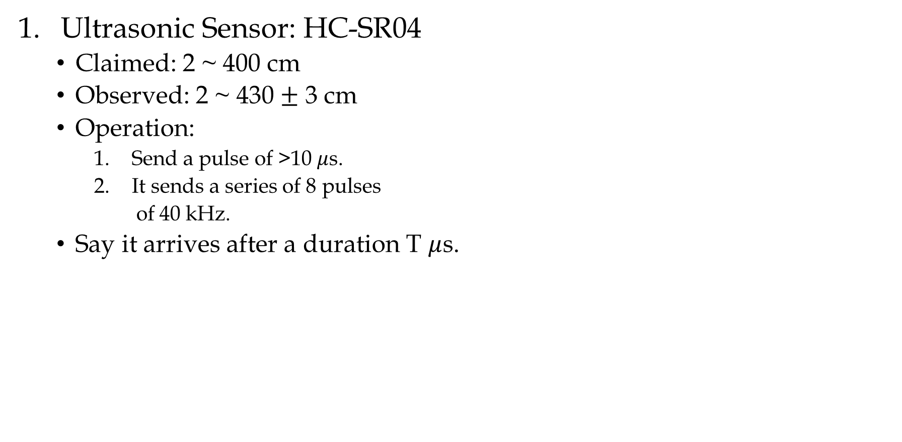
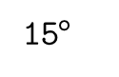
Hardware
Ultrasonic Sensor: HC-SR04
Claimed: 2 ~ 400 cm
Observed: 2 ~ 430 $±$ 3 cm
Operation:
Send a pulse of >10 $μ$s.
It sends a series of 8 pulses
of 40 kHz.
Say it arrives after a duration T $μ$s.
Ultrasonic Sensor
Tx
Rx
15$°$

Slide 8
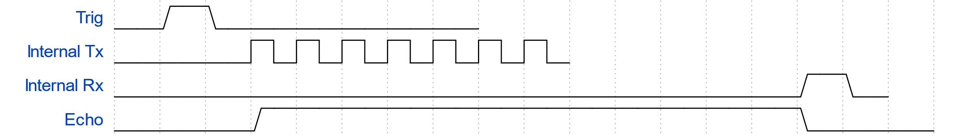
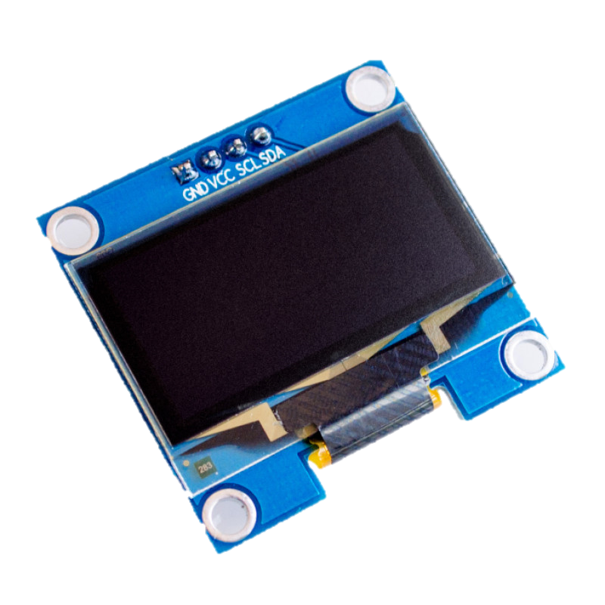
Hardware
HC-SR04 continued …
OLED
128 x 64 pixels resolution.
SSD1306 controller
I2C communication interface.
Used as a visual aid along with on-board LED.
3.3V supply required.

Slide 9
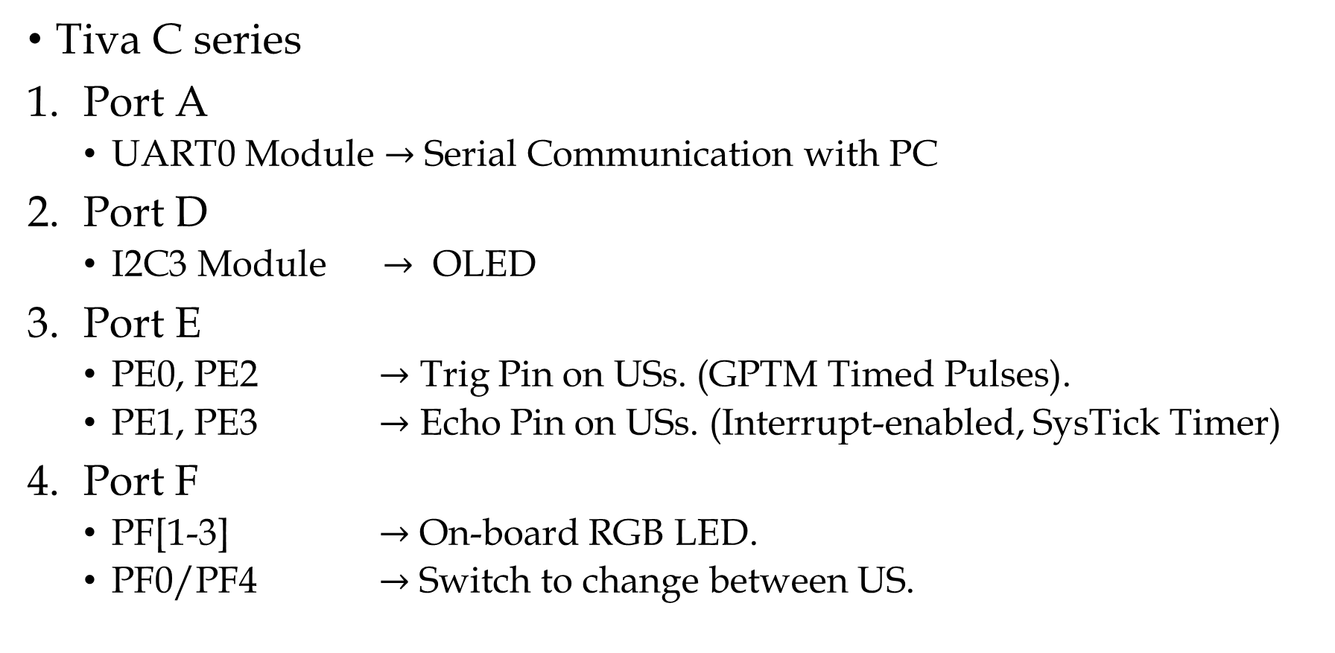
Implementation Details
Tiva C series
Port A
UART0 Module $→$ Serial Communication with PC
Port D
I2C3 Module $→$ OLED
Port E
PE0, PE2 $→$ Trig Pin on USs. (GPTM Timed Pulses).
PE1, PE3 $→$ Echo Pin on USs. (Interrupt-enabled, SysTick Timer)
Port F
PF[1-3] $→$ On-board RGB LED.
PF0/PF4 $→$ Switch to change between US.

Slide 10

Software
readEcho_ISR() ;
* - This interrupt routine executes at positive edge of Echo Pin
Initializations
Check switch
Start Systick Timer from COUNT_MAX
Set Trig High (1)
Wait for negative edge on Echo Pin
Wait (10$μ$s)
Extract time elapsed from the STCURRENT
Set Trig Low (0)
Convert to distance
Wait for (Echo*)
Convert to string and output to OLED

Slide 11
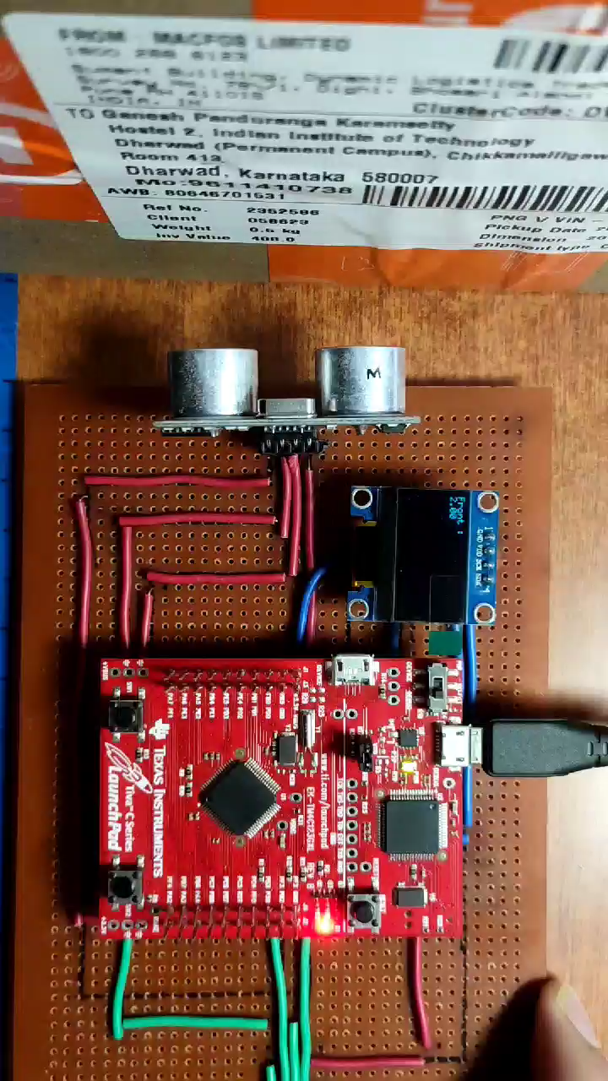
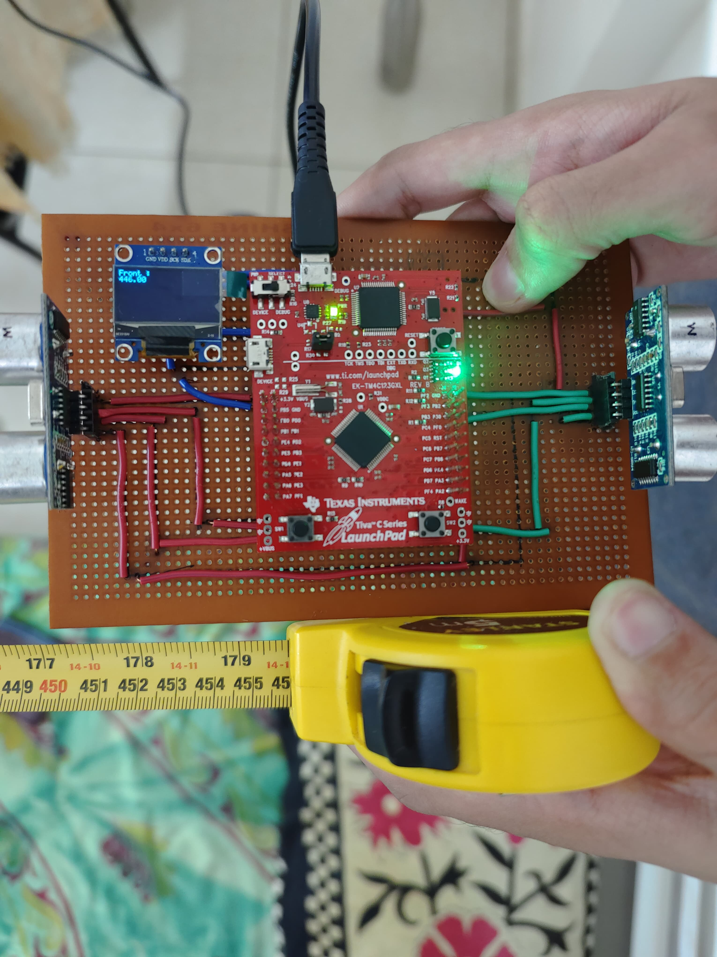
Demo Time🙂

Slide 12
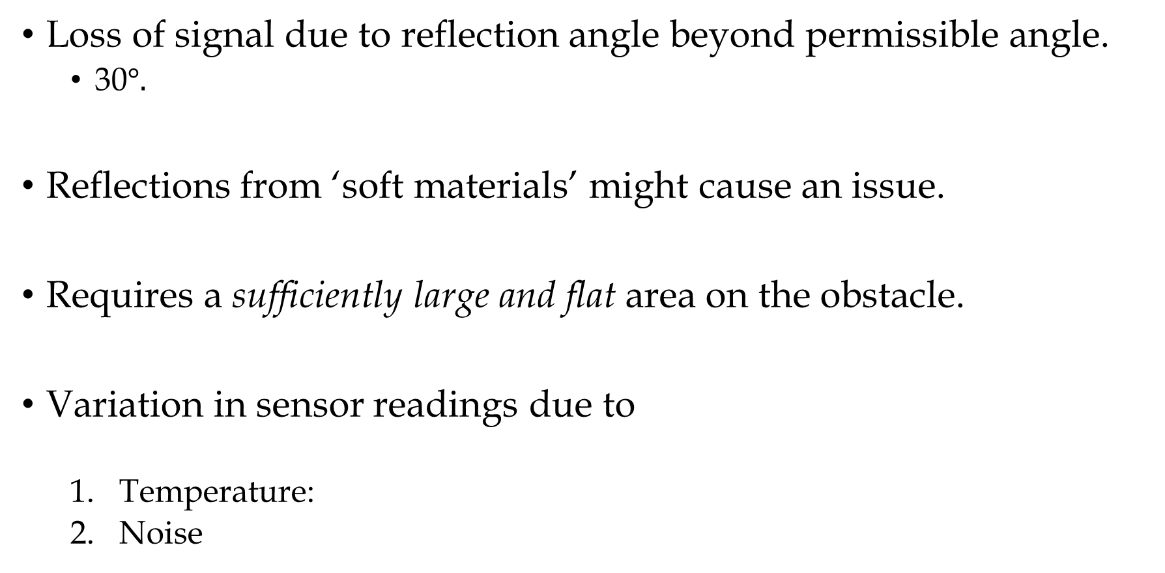
Limitations
Loss of signal due to reflection angle beyond permissible angle.
30$°.$
Reflections from ‘soft materials’ might cause an issue.
Requires a sufficiently large and flat area on the obstacle.
Variation in sensor readings due to
Temperature:
Noise

Slide 13
Bill of Materials – Cost Analysis
 | Item | Per unit Cost (in ₹) | Quantity | Cost (in ₹)
1 | HC-SR04 | 55 | 2 | 110
2 | OLED 128 * 64 | 169 | 1 | 169
3 | Tiva C series Launchpad | 1720.3 | 1 | 1720.3
4 | Misc.(Wires, PCB, Soldering material) | 100 | 1 | 100
 | Total |  |  | 2099.3

Slide 14
Summary
Possible improvements:
Hardware
Better quality (accuracy, precision) sensors.
To keep costs down, a cheaper and slightly slower microcontroller.
Only requirements: UART/I2C, ~3 GPIO ports, 2 independent timers.
Software
Memory/ Execution time optimizations.
Better Graphics
Displaying data that can be immediately registered by our brain.
We want to give a sense of direction.
Adding auditory warnings.

Slide 15
References
Wikipedia contributors. (2024, November 24). Advanced driver-assistance system. In Wikipedia, The Free Encyclopedia. Retrieved 13:40, November 28, 2024, from https://en.wikipedia.org/w/index.php?title=Advanced_driver-assistance_system&oldid=1259320619
Wikipedia contributors. (2024, September 6). Parking sensor. In Wikipedia, The Free Encyclopedia. Retrieved 02:32, November 29, 2024, from https://en.wikipedia.org/w/index.php?title=Parking_sensor&oldid=1244346724
https://robu.in/wp-content/uploads/2014/08/edited_HC-SR04-User-Manual-1.pdf
Tiva C series TM4C123GXL Launchpad development board, https://www.ti.com/product/TM4C123GH6PM
OLED Datasheet, https://cdn-shop.adafruit.com/datasheets/SSD1306.pdf

Slide 16
Thank You
Rishabh Pomaje
Ganesh Panduranga Karamsetty

